Slide 1
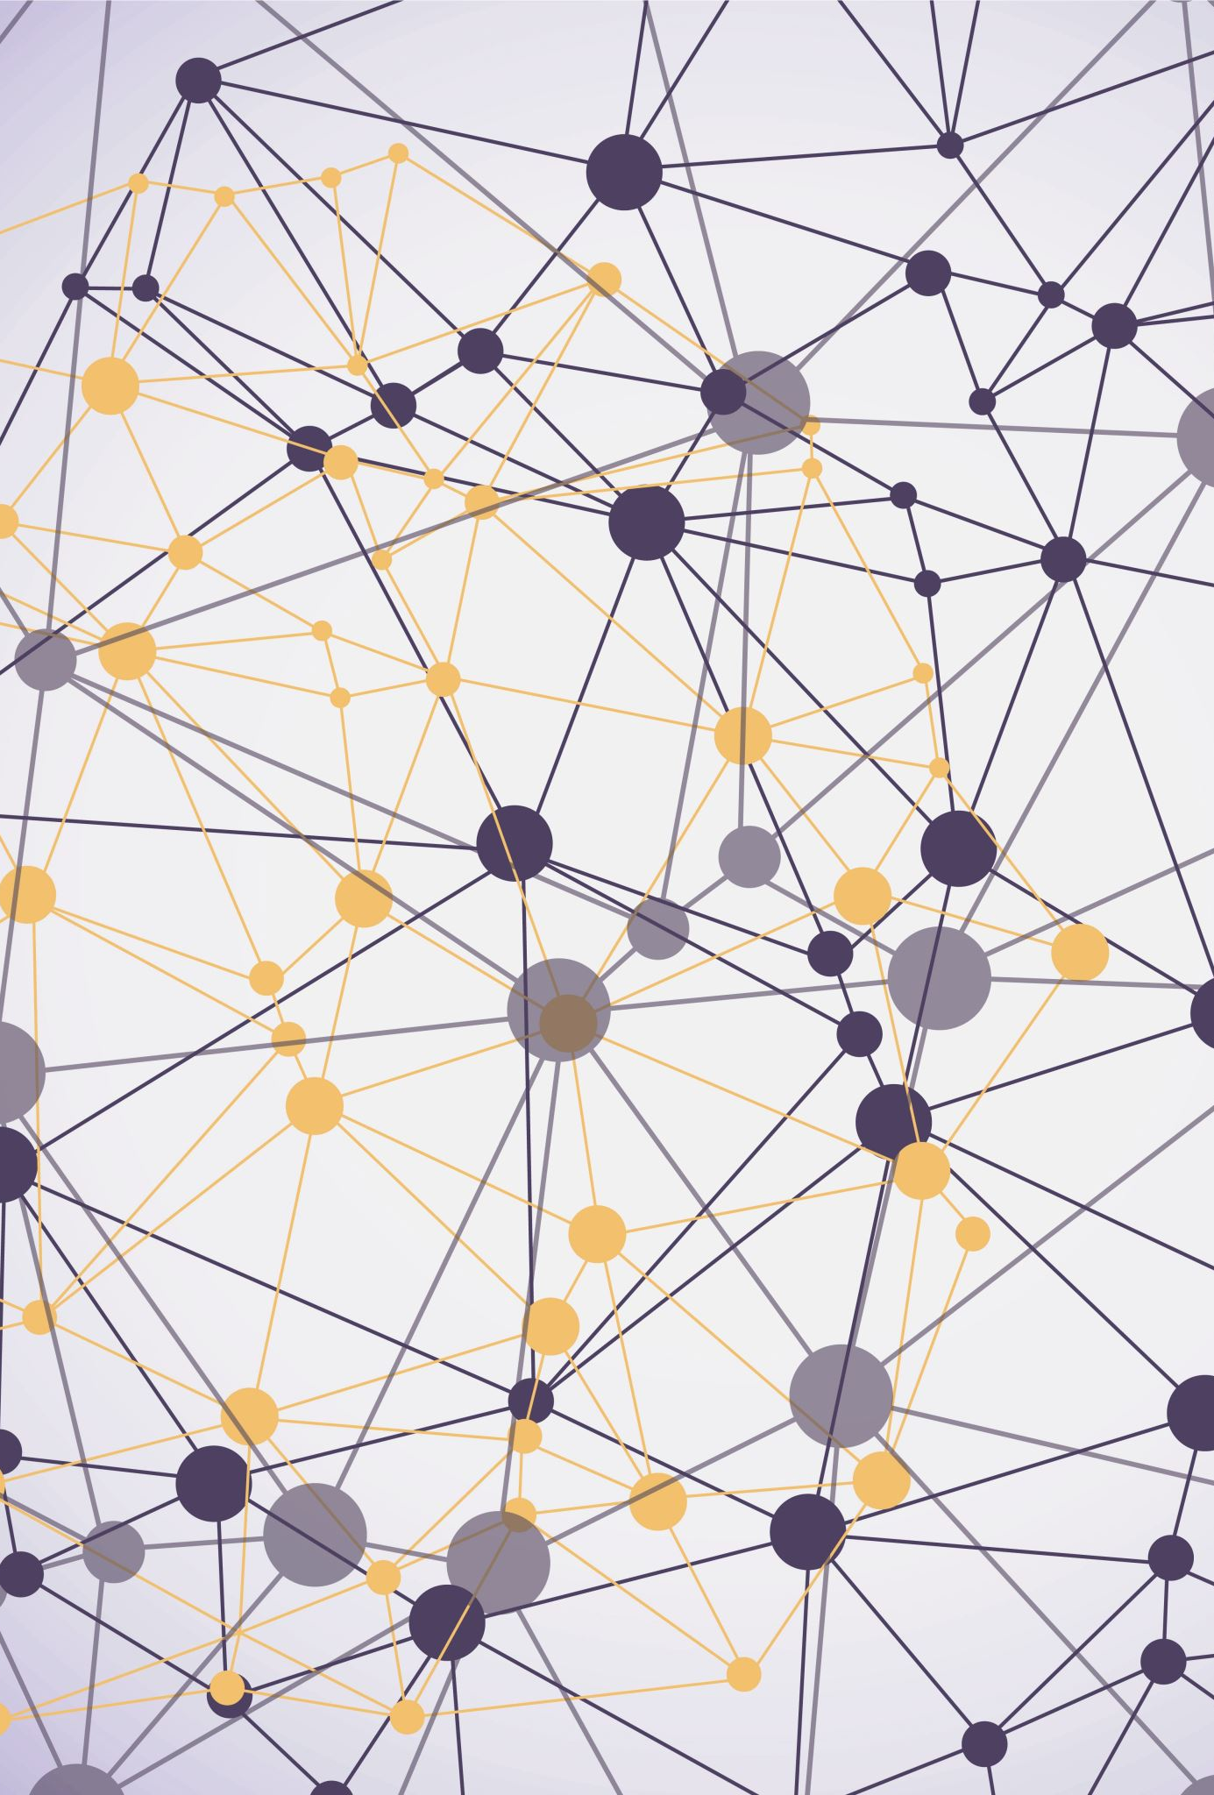
Quantum Software Development Final Project
Seixas Aldrich

Slide 2
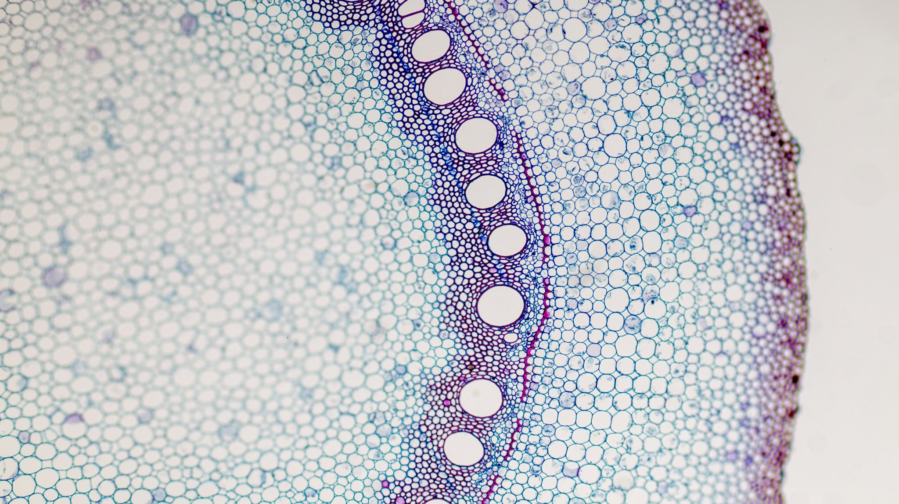
Two’s Complement

Slide 3
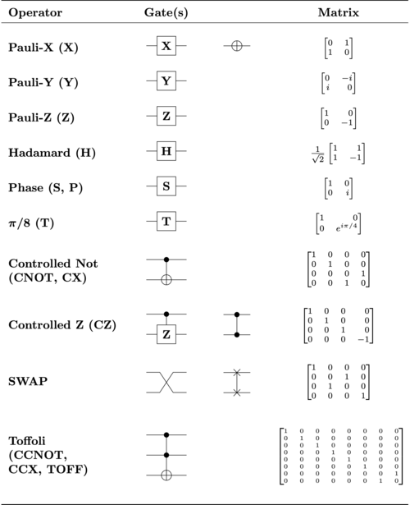
Background Context
A qubit’s state is the superposition (sum) of its |0> and |1> components. (a and b are amplitudes)
|Q> = a|0> + b|1>
Measurement sets a qubit to |0> or |1> probabilistically.
|a|^2 + |b|^2 = 1
A list of the most common quantum gates are shown to the right.

Slide 4

Two’s Complement Algorithm
Takes in a signed integer of any size in binary
This input is a register of Qubits, one for each binary bit.
The first step is flipping every bit/qubit in the number.
The second and final step is adding 1 to the number.

Slide 5
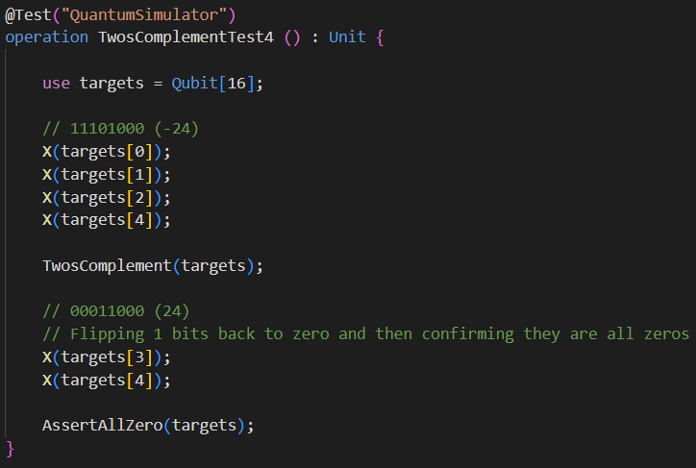
Two’s Complement Algorithm in Quantum Testing

Slide 6
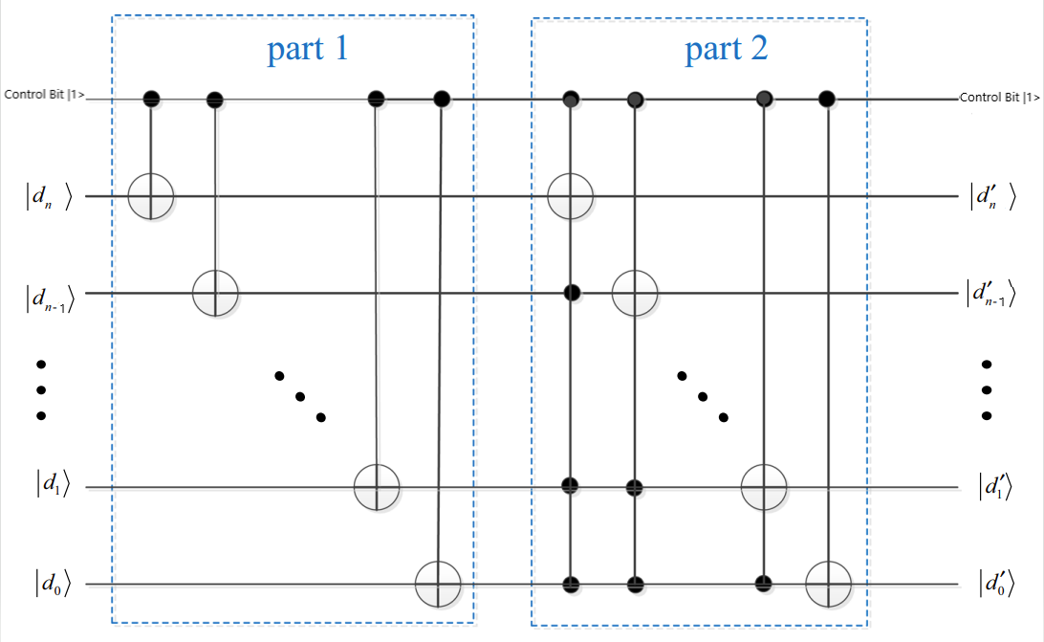
Two’s Complement Algorithm in Quantum

Slide 7

Why Did I Do This?
Two’s Complement algorithm is a basic algorithm that is a part of many larger systems, including anything with subtraction.
This means getting a baseline knowledge with this could help me with more quantum algorithms in the future.
In my research I found multiple papers on very high-level quantum algorithms and they were describing their method of two’s complementing as it was needed.

Slide 8
What Did I Learn?
Quantum algorithms, when you have no starting point or guide, are very difficult to formulate.
It takes a lot of research and writing out what each gate will do to get anywhere when making one.
Makes me feel a lot of respect for anyone who makes very large quantum programs or algorithms.

Slide 9

Future Endeavors
I would love to work on more quantum computing in the future, especially on coding larger algorithms.
Also, researching the actual physics behind the quantum computers and having my code run on a real one would be very cool.
Finally, doing resource estimation was a goal for this project, but due to time constraints and difficulties with it I could not complete it.

